Slide 1





VMware, SQL Server and Encrypting Private Data
PNW SQL Server User Group
Townsend Security
724 Columbia Street NW, Suite 400 | Olympia, WA 98501 | 360.359.4400 | www.townsendsecurity.com

Slide 2


Today’s Agenda
What’s new from Microsoft?
Compliance, standards, and best practices
Encryption and key management
Encrypting Data on SQL Server
Alliance Key Manager
www.townsendsecurity.com

Slide 3
What’s new from Microsoft
SQL Server 2016 Always Encrypted
Azure SQL Server TDE
Dynamic Data Masking (code changes)
Row and Column level security (playing catch-up)
Azure Resource Manager (ARM)
www.townsendsecurity.com

Slide 4
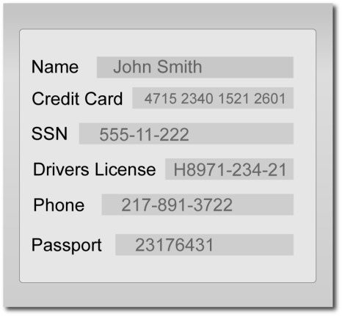
What is Considered Sensitive Data?
Attackers are great aggregators. Losing a little PII can mean big losses for consumers and customers.
Email address
Social security number / Tax ID
Password
ZIP code
Health information
Credit card number
And much more!
www.townsendsecurity.com

Slide 5

Compliance Regulations Drive Encryption
Your customers expect you to protect their data.
Government and industry created regulations require you to protect personal data.
State and proposed Federal Privacy Notification laws
PCI Data Security Standard (PCI DSS) for Merchants and Acquirers
HIPAA Data Security and HITECH ACT of 2009 for medical providers
GLBA / FFIEC for the financial industry
FISMA for US Government agencies
Federal Trade Commission (FTC) enforcement
www.townsendsecurity.com

Slide 6

What Encryption Should I Use?
Use AES, RSA, Triple DES, or other standard methods
Beware of non-standard encryption
Example: Homomorphic encryption
Has not received wide review and acceptance
Cannot be certified by a standards body
Cannot achieve FIPS 140-2 validation
Compliance regulations prohibit its use
The best encryption algorithms are open, vetted, and independently reviewed like AES – which means NIST certified
www.townsendsecurity.com

Slide 7

Impacts of Encryption
Performance – Expect a 2-4% overhead
Backup and Restore Operations – Can take longer as information is encrypted and compression is less effective
High Availability – In the event of an interruption, you need to easily restore your keys from a backup key management solution
www.townsendsecurity.com

Slide 8
Why is Key Management Important?
Encryption keys are THE secret that must be protected (not the algorithm)
There are industry standards and best practices for key management (NIST)
Compliance regulations (PCI, HIPAA, etc.) require proper key management
Separate encryption control and ownership from the cloud provider
www.townsendsecurity.com

Slide 9
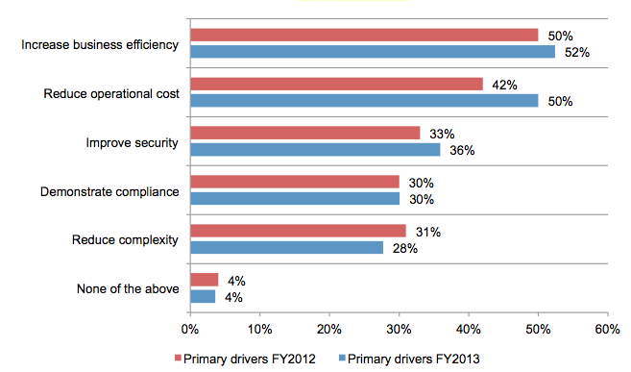


Benefits of Encryption Key Management
* Global Encryption Trends
www.townsendsecurity.com

Slide 10

Key Management Standards – NIST & KMIP
NIST Special Publication SP 800-57 Best Practices for Key Management
NIST FIPS 140-2 for certification
Key Management Interoperability Protocol (KMIP)
This is a “wire” protocol using SSL/TLS
OASIS standards group
Version 1.3 is complete
Base support with optional profiles
Now prevails over IEEE 1619.3, etc.
KMIP
www.townsendsecurity.com

Slide 11
Key Management Best Practices
Dual Control - Two or more people control a single procedure
Separation of Duties - Different people control different procedures so that no one person controls multiple procedures
Split Knowledge - Prevents any one person from knowing the complete value of an encryption key or passcode
www.townsendsecurity.com

Slide 12





Key Management Server & Key Retrieval
Key Server
TLS SECURE
Secure Key Database
Logs & Audits
SQL Server
www.townsendsecurity.com

Slide 13

Key Server - Creating and Storing Keys
Creating strong Data Encryption Keys (DEK)
Creating strong Key Encryption Keys (KEK)
Defining crypto-periods for DEK, KEK
Keys have attributes
www.townsendsecurity.com

Slide 14
Creating Strong Symmetric Keys
Cryptographically secure pseudo random number generator
CS-PRNG
NEVER use passwords as keys
www.townsendsecurity.com

Slide 15
Secure Key Storage for Data Encryption Keys
Confidentiality and integrity
Separation of keys from protected data
Use of a Master Key Encryption Key (KEK)
Storage in hardware device or HSM
Defined crypto-periods for KEK, DEK
NIST defines best practices and standards
www.townsendsecurity.com

Slide 16

Key Attributes
Name, version, activation date, expiration date, uses (signing, encryption, etc.), status, rollover, interval, integrity information, user data, etc.
Order Key
Expires 10/10/2014
Rollover Every 90 Days
Active
www.townsendsecurity.com

Slide 17
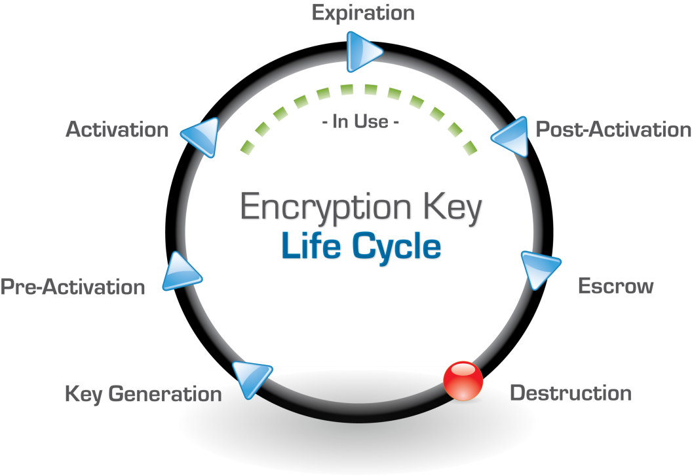
www.townsendsecurity.com

Slide 18


Distributing Keys
Isolate keys from protected data
Secure encrypted retrieval with TLS 1.2
Wire vs. API implementation
Mutually authenticated retrieval
Client platform support
Import & export
- Interoperability
www.townsendsecurity.com

Slide 19

Access Controls
End-point authentication
User authentication
Group or role-based controls
Access audit
www.townsendsecurity.com

Slide 20

Key Access and Business Recovery
Backup and recovery
High Availability
Backup on schedule
Secure transfer of DEK and KEK
Backup and restore audit
www.townsendsecurity.com

Slide 21

Systems Management
Server management separate from key management
Network configuration (address, gateway)
Server security (users, passwords, firewall, …)
Problem collection and reporting
System logging and log rotation
System date/time management
www.townsendsecurity.com

Slide 22

Log Collection and Audit
Collect logs and transmit to log collection server or SIEM solution
System logs and configuration changes
Key retrieval audit logs
Key manage activity
Log rotation and compression
<34> May 10 22:10:13 KeyServer retrieve: key <ORDERS> retrieved by user <Bill> from source IP <10.0.1.10>
www.townsendsecurity.com

Slide 23

Barriers to Deploying Encryption & Key Management
Why Projects Can Be Hard
Complicated projects that require outside consultants and a lot of time
Vendor sample code missing or poor quality
Lacking in client-side applications
Complex evaluation procedures
Complex and hard to predict licensing
www.townsendsecurity.com

Slide 24

Encryption and Key Management in VMware
Challenges, Best Practices & What to Know:
VMware is NOT responsible for YOUR breach
VMware segmentation (managing multi-tenancy)
Business recovery – Production and High Availability
Backup and restore
Hybrid environments – more the rule than the exception
VMware has reference architectures – very helpful!
www.townsendsecurity.com

Slide 25
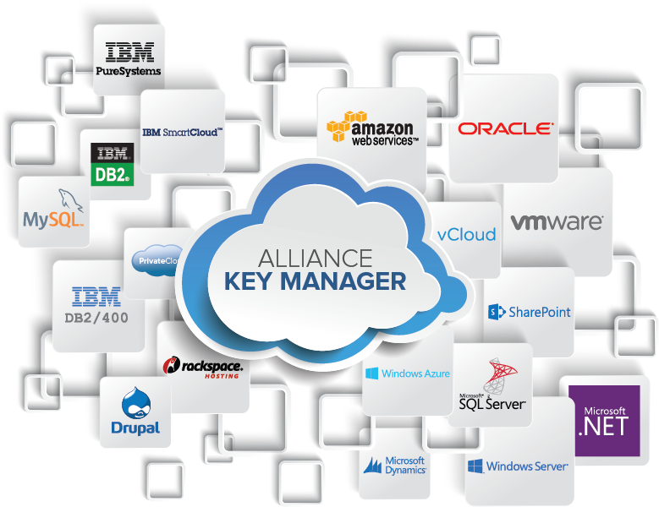
www.townsendsecurity.com

Slide 26



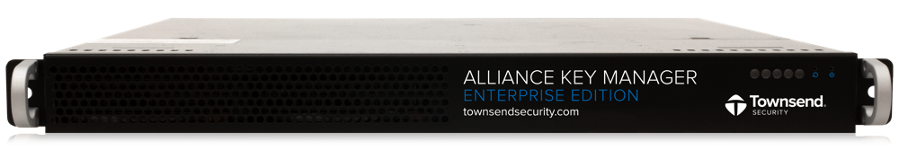
Alliance Key Manager – Available Platforms
Support for every platform with a common interface
Hardware Security Module (HSM)
Cloud HSM
Virtual Machine – VMware
Cloud VM – AWS (AMI), Azure, IBM Cloud, vCloud
Microsoft Azure
www.townsendsecurity.com

Slide 27
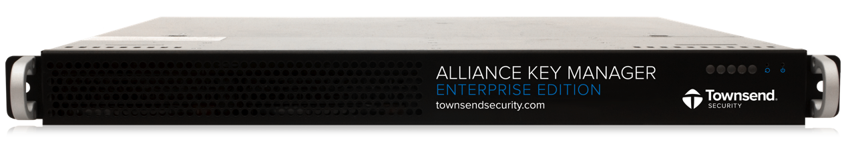

Alliance Key Manager:
System Capabilities
Secure key storage
Secure key retrieval
Access controls for users and groups
In-depth system logging
Full-function audit trails
Key import and export abilities
Secure console administration
Dual control capability
Separation of duties enforcement
Robust metadata capability
www.townsendsecurity.com

Slide 28

Encryption as a Service
Use NIST-compliant AES encryption
Encryption key never leaves the server
Use cases: web applications, cloud applications, kiosks
www.townsendsecurity.com

Slide 29

Alliance Key Manager: Ready to Use
Creates Certificate Authority unique to you
Creates Web server certificates and private keys unique to you
Creates a set of encryption keys unique to you
Creates client-side certificates and private keys unique to you
A fully functional key management solution ready to use in SECONDS!
www.townsendsecurity.com

Slide 30
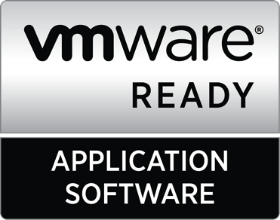
Alliance Key Manager for VMware
Same FIPS 140-2 compliant technology as in HSM
Lower operational costs and IT footprint
Accelerate deployment of missions critical security technology
Supports VMware ESXi, vSphere, and vCloud
VMware Technology Alliance Partner (TAP)
www.townsendsecurity.com

Slide 31

Alliance Key Manager for SQL Server Enterprise Edition
Encryption and key management with no programming
Easily integrates with Microsoft SQL Server
Supports TDE & EKM
Supports Cell Level Encryption
www.townsendsecurity.com

Slide 32
Alliance Key Manager for SQL Server Standard & Web Editions
No EKM, No Problem
Software libraries for .NET applications
Supports CLR implementation
Ideal for Standard and Web Editions
Partnering with NetLib for folder/TDE approach
www.townsendsecurity.com

Slide 33

Automated Encryption Using C#
ADD
Alliance Key Manager
Client Assembly DLL
using System;
using System.Collections.Generic;
using System.Linq;
using System.Security.Cryptography;
using System.Text;
using Microsoft.SqlServer.Server;
using Townsend.Alliance;
public class EncryptDecryptUdf
{
#region Public Methods and Operators
// The SqlFacet attribute defines these as varbinary(max) for data up to 2^31-1 bytes long.
Insert call to:
Retrieve a key
On-board encryption
module.cs
www.townsendsecurity.com

Slide 34





Any Questions About VMware, SQL Server and Encryption Key Management?
> Secure Keys. Meet Compliance Requirements.
Securely manage keys for data encrypted on ANY platform: Windows Linux, UNIX, IBM i, IBM z
FIPS 140-2 compliance | Low cost. Comprehensive solution.
Contact Townsend Security:
patrick.townsend@townsendsecurity.com
www.townsendsecurity.com
800.357.1019
www.townsendsecurity.com

